Slide 1

Decentralized Cloud Storage System
By: Roshan Baig Moghal

Slide 2
What is Decentralized Cloud Storage?
Decentralized Cloud Storage refers to a cloud storage model where data is distributed across a network of independent nodes rather than being stored in centralized data centers owned by a single company.
In this system, data is fragmented, encrypted, and stored in different locations, making it more secure, private, and resistant to single points of failure.
In this approach we are using blockchain and peer-to-peer (P2P) networks, such as the InterPlanetary File System (IPFS).

Slide 3
Key Features of Decentralized Cloud Storage:
Data Security: Data is encrypted and stored across multiple nodes, protecting it from unauthorized access or breaches.
Privacy: Users have greater control over their data, and no single entity has access to the entire file.
Redundancy and Availability: Since the data is fragmented and stored in multiple locations, it is highly available and resistant to hardware failures.
Cost-Effective: Users can share unused storage space, reducing storage costs compared to traditional centralized services.
Censorship Resistance: Decentralized storage systems are harder to shut down or censor, as no single authority controls the entire network.

Slide 4
System Architecture
Frontend (User Interface)
Tech: React.js
Role: File upload/download, manage access
MetaMask Integration: User authentication
Blockchain Layer
Tech: Ethereum, Smart Contracts
Role: Store file metadata (CID), manage file ownership and permissions
Smart Contracts: Ensure transparency and immutability
Storage Layer (IPFS)
Tech: Pinata (Decentralized File Storage)
Role: Distribute and store files across nodes
CID: Unique file identifier for retrieval
Middleware
Tech: Web3.js, Ethers.js
Role: Facilitates blockchain and frontend interaction, handles transactions
Wallet Integration (MetaMask)
Role: Manages user identity and transaction signing

Slide 5
Setup Guide
Prerequisites:
MetaMask (Connected to Ganache)
Node.js (v12+), ethers.js, IPFS (Pinata)
Steps:
Clone Repo: git clone https://github.com/Roshan003/Decentralized-Cloud-Storage.git
Install Dependencies: npm install
API Keys: Change the API key and secret key
Run App: npm start
Opens on http://localhost:3000

Slide 6
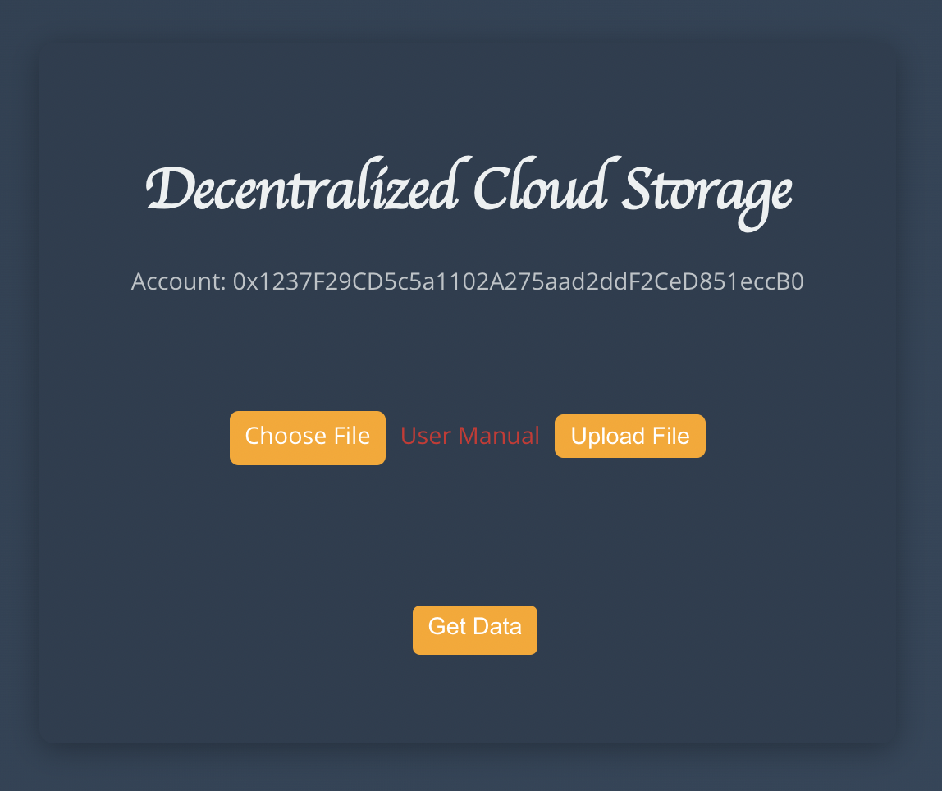
Uploading Files to IPFS
Step 1: Connect MetaMask Wallet.
Step 2: Select and upload files via the UI.
Step 3: Confirm the blockchain transaction.
Files are stored on IPFS, with the CID saved on Ethereum.

Slide 7
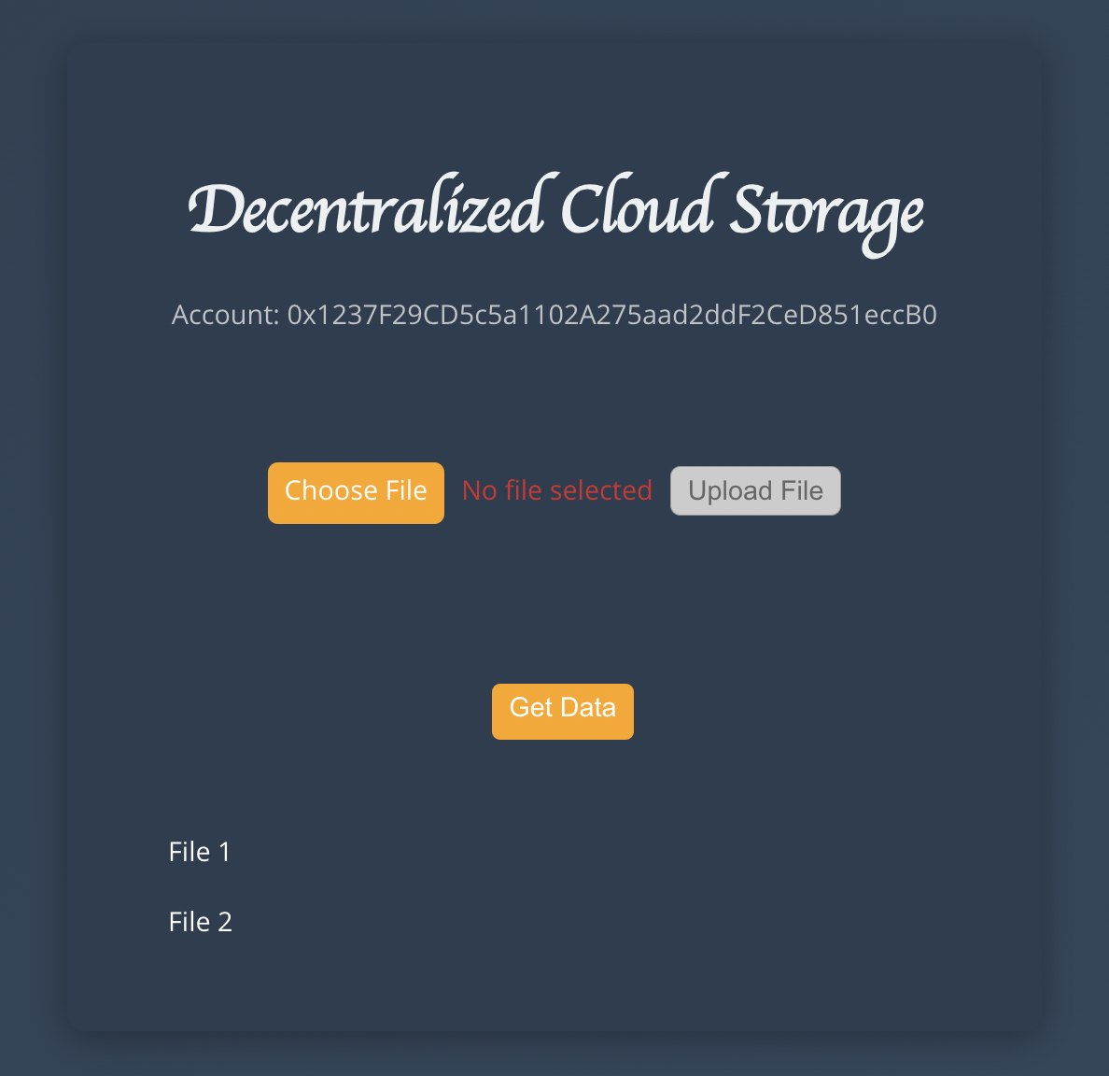
Viewing and Retrieving Files
Files are listed with their IPFS CID.
Click on CID to view/download the file via IPFS.
Publicly accessible using any IPFS gateway.

Slide 8

Thank You

